Slide 1
Houston's Flood Vulnerability
By: Ahmed Alouddi, Erik Guzman, Gurvinder Bhogal, William Takahashi, Ediyanga Amos
Team: AQUA

Slide 2
Content
Introduction and Problem Statement
Solution
Goals/Objectives
Technical Specifications and Project Management
Budget and Schedule
References

Slide 3
Introduction and Problem Statement
Floods are a major issue in Houston, Texas. Floods are caused by hurricanes, heavy rainfall, and overflows of rivers. Floods create many casualties like property damage and deaths. Most people cannot make it to safety on time.

Slide 4
Situational Context
Flooding occurs from a multitude of reasons and can cause major property damage.
In 2017, the city of Houston Texas was hit by Hurricane Harvey that resulted in 4 to 5 feet high water levels.
It cause massive amount of property damage and affected millions of people.
Although this is a near extreme scenario, flooding occurs more frequently than it did in previous decades.

Slide 5
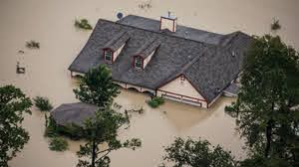
What is the Problem?
People who live in flood prone areas do not always have safe places to stay nearby during and after a flood disaster and some flood shelters are not safe enough to hold people during disasters.
Therefore, people need a safer placed that are more accessible and will aid the disaster recovery efforts.
Figure 1

Slide 6
Our Proposed Solution
Constructing permanent safety/flood proof shelters to cities in Houston, Texas. Since Houston, Texas already has rescue operations and systems in place, the shelters would be the main location that people would be sent to for safety.

Slide 7
Why this Solution?
There is no way we can stop floods. They will happen no matter what.
But at least, we can do is help the people get to a safe and reliable place during their time of recovery.
Figure 2

Slide 8
Goals/Objectives
1) Get authorization from the mayor of Texas.
2) Get the funds approved by the Texas water board program.
3) Checking out certain areas and confirming where the shelters will be placed.
4) Constructing the permanent shelters.

Slide 9
Technical Specifications and Project Management
We will apply for a flood infrastructure fund through the Texas Water Board program.
After getting authorization from the mayor to build these shelters, we will go through the city in the first 6 months to plan out where each shelter will be and check out to see if the space to build the shelter is good enough in the area.

Slide 10
Requirements and Materials Needed
Figure 3
Concrete is a strong and flood resistant material that can be used both indoors and outdoors.
Concrete is also easily cleaned and restored preventing extra labor required to remove toxins from the flood.
We will also be using steel and foam insulation to better ensure that water doesn’t come through.
For fasteners, only stainless-steel fasteners will be used. These fasteners include nails, screws, bolts, and anchors.

Slide 11
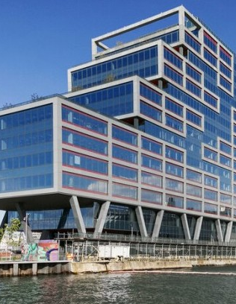
Architecture Design
Figure 4
The most important part of the design is to elevate the lowest floor of the shelter to be above the base flood elevation (BFE).
All the construction below the BFE is susceptible to flooding

Slide 12
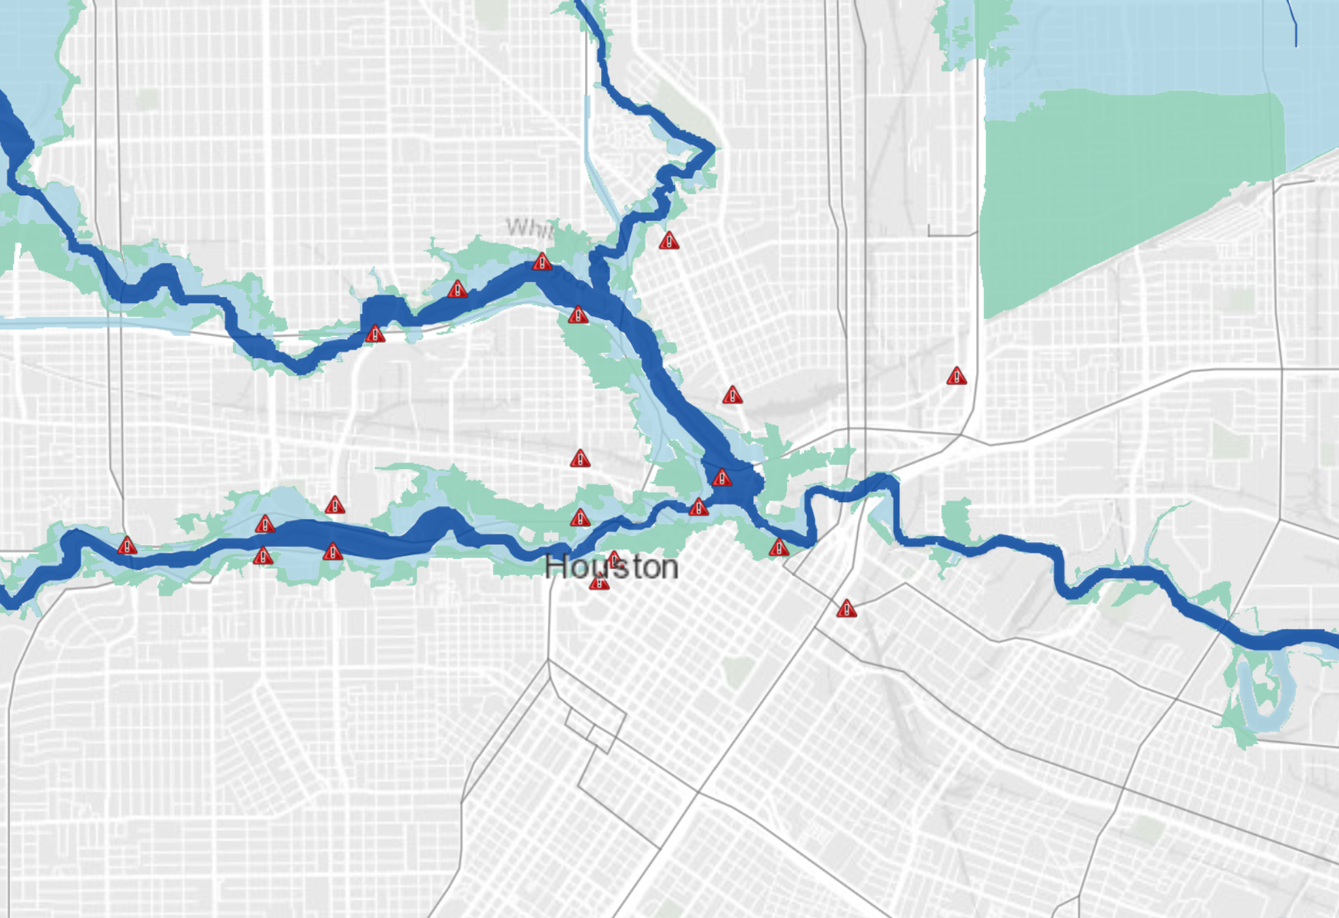
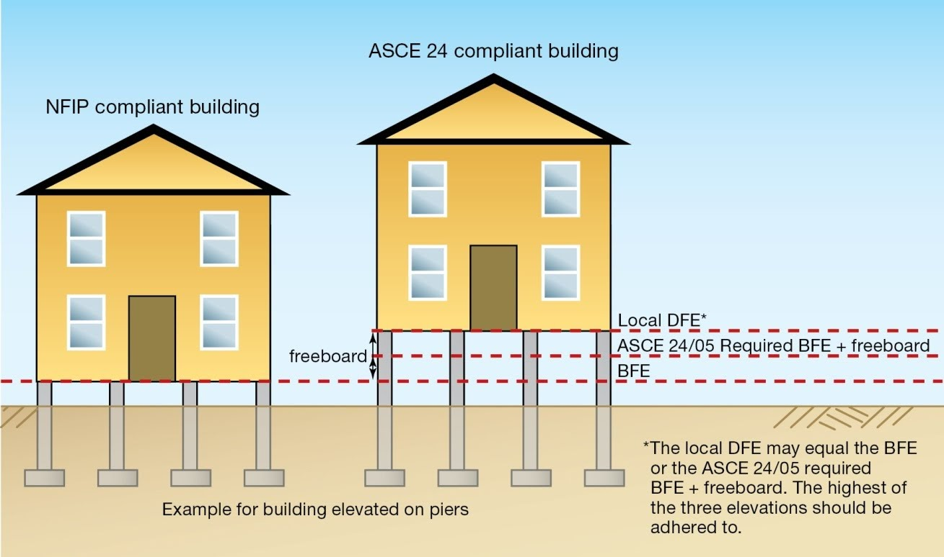
Implementation of Design
The stilts are 4 feet above the floor, and there will be pillars holding the building. There are 3 floors on each building that will hold 200~300 people. The interior will have water-proof foam insulation. There will be food, water, clothing, showers, and daily needs supplies. We will be creating these shelters in areas where its prone to flooding
Figure 5
Figure 6

Slide 13
Quantity Assurance Plan
To construct flood resistant shelters in areas around Houston neighborhoods for people to reach safety quicker during floods.
These shelters would provide food, water and other supplies during the floods so people can temporarily stay there until the flood has been cleared and they are able to get back to their homes or find new residence.
The structure will act as a firewall against floods. It will be able to withstand the forces of the water and the toxins from the flood can be easily cleaned and restored due to the material we will be using.

Slide 14
Estimated Production Costs
Description | Unit per each shelter home | Total Project Cost per each shelter home
Land | $4,293 per acre | $592
Workers | $17 per worker (60) | $86,700
Manufacturing Space | 3 floor building | $3.6 million
Utilities | Supplies & Needs | $200,000
Staff Members | 15 staff members | $21/hr per staff member
Total Costs |  | $3,917,292

Slide 15
Schedule
Date | Tasks
01/01/21 | Request authority from mayor and request funds
02/05/21 - 08/05/21 | Look around Houston and check spots that will allow people will be able to access the shelters easier and faster
08/06/21 - 04/06/22 | Receive the equipment and structures needed and begin constructing the shelters in the designated areas
04/10/22 - 04/21/22 | The shelters are checked to make sure they are well constructed and there are no errors so that we can ensure the buildings safe.
05/20/22 | Supplies and equipment are placed inside the shelters

Slide 16
References
FLOOD RETROFITTING AND RECONSTRUCTION PROJECTS IN THE SANDY-IMPACTED AREAS. (2013). Retrieved November 30, 2020, from https://www.sites.google.com/site/metropolitanforensics/flood-retrofitting-and-reconstruction-projects-in-the-sandy-impacted-areas?tmpl=%2Fsystem%2Fapp%2Ftemplates%2Fprint%2F
Koss, H. (2020). THE STARTUPS CREATING CONCRETE ALTERNATIVES. Retrieved December 01, 2020, from https://www.architectmagazine.com/aia-architect/aiafeature/battling-a-flooded-future_o%20%E2%80%8B
Paletta, A. (2019). Battling a Flooded Future. Retrieved December 01, 2020, from https://www.architectmagazine.com/aia-architect/aiafeature/battling-a-flooded-future_o
S. (n.d.). Explore Houston's flood-prone areas. Retrieved December 01, 2020, from https://www.houstonchronicle.com/about/item/Map-Flood-prone-areas-map-83183.php
Thesheetztweetz. (2017, August 30). Extraordinary photos of survival in Houston. Retrieved December 01, 2020, from https://www.cnbc.com/2017/08/30/extraordinary-photos-of-survival-in-houston-flooding.html
http://www.theijes.com/papers/v2-i8/Part.2/C282018029.pdf

